Slide 1
Technology representation in OSeMSOYS: input and output commodities
In OSeMOSYS, they are assigned through two parameters: InputActivityRatio and OutputActivityRatio.

Slide 2
Technology representation in OSeMSOYS: input and output commodities
In OSeMOSYS, they are assigned through two parameters: InputActivityRatio and OutputActivityRatio.
Example: a bakery has one bread-making machine.
If the machine is loaded with 5 kg of flour and 4 litres of water, it produces 50 baguettes.

Slide 3
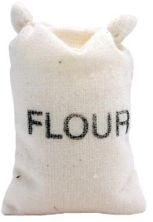
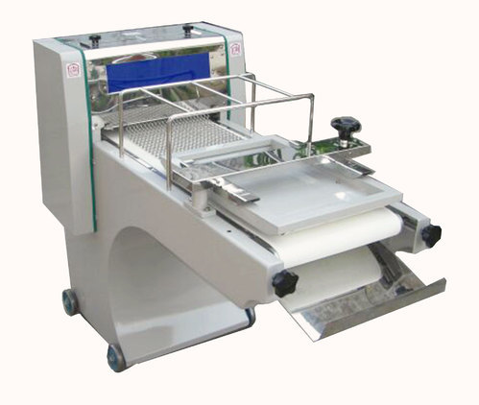
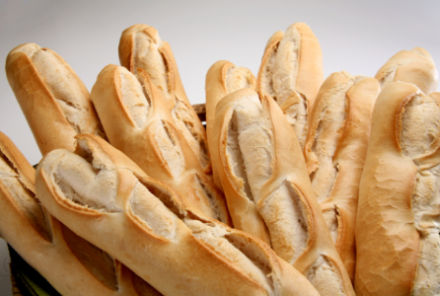
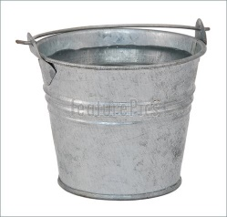
Technology representation in OSeMSOYS: input and output commodities
If the machine is loaded with 5 kg of flour and 4 litres of water, it produces 50 baguettes.
50 baguettes
5 kg
4 l

Slide 4
Technology representation in OSeMSOYS: input and output commodities
Then, to produce 1 baguette, 100 g of flour and 80 cl of water are needed.
1 baguette
100 g
80 cl

Slide 5
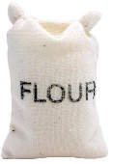

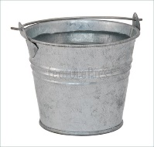
Technology representation in OSeMSOYS: input and output commodities
In OSeMOSYS we would say that for an
OutputActivityRatio for baguette = 1
We need (using the units displayed on the right)
InputActivityRatio for flour = 100
InputActivityRatio for water = 80
100 g
1 baguette
80 cl

Slide 6
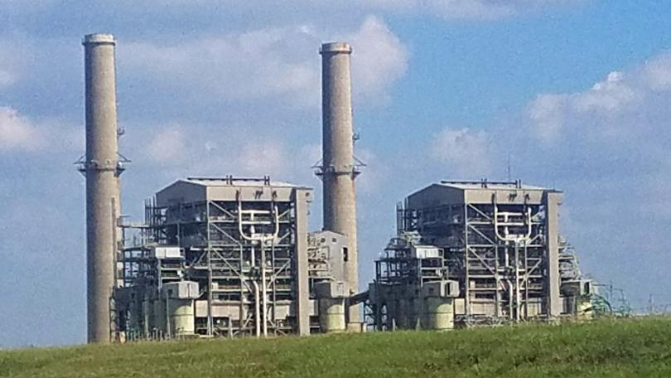

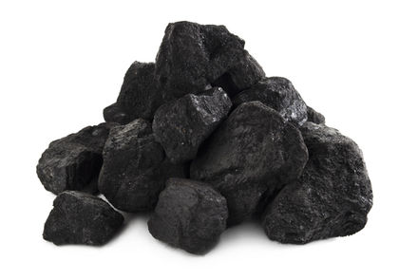
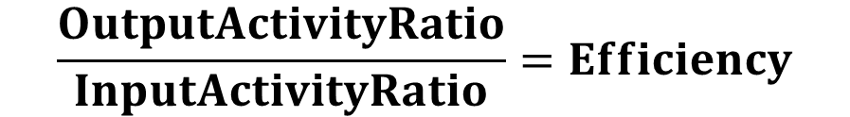
Technology representation in OSeMSOYS: input and output commodities
The same concept can be extended to anything representing a process with inputs and outputs, e.g. a power plant:
$$\frac{OutputActivityRatio}{InputActivityRatio}=Efficiency$$
NB! For a power plant:

Slide 7

Technology representation in OSeMSOYS: input and output commodities
Example: in our bakery, we only have one machine. With the flour and water input we showed above, the machine takes 1 hour to produce 50 baguettes. Let us assume we load the machine now. How much can we produce?
50 baguettes per hour
50 baguettes in the next hour

Slide 8

Technology representation in OSeMSOYS: input and output commodities
Example: in our bakery, we only have one machine. With the flour and water input we showed above, the machine takes 1 hour to produce 50 baguettes. Let us assume we load the baguette now. How much can we produce?
50 baguettes per hour
100 baguettes in the next hour

Slide 9
Technology representation in OSeMSOYS: input and output commodities
Example: in our bakery, we only have one machine. With the flour and water input we showed above, the machine takes 1 hour to produce 50 baguettes. Let us assume we load the baguette now. How much can we produce?
50 baguettes per hour
100 baguettes in the next 2 hours

Slide 10
Technology representation in OSeMSOYS: input and output commodities
Example: in our bakery, we only have one machine. With the flour and water input we showed above, the machine takes 1 hour to produce 50 baguettes. Let us assume we load the baguette now. How much can we produce?
50 baguettes per hour
150 baguettes in the next 3 hours

Slide 11
Technology representation in OSeMSOYS: input and output commodities
Example: in our bakery, we only have one machine. With the flour and water input we showed above, the machine takes 1 hour to produce 50 baguettes. Let us assume we load the baguette now. How much can we produce?
CAPACITY: 50 baguettes per hour
ACTIVITY: 150 baguettes in the next 3 hours

Slide 12
Technology representation in OSeMSOYS: input and output commodities
If we want to sell more baguettes, either we keep one machine and take more time, or we install more machines in the bakery.
CAPACITY: 50 baguettes per hour
ACTIVITY: 150 baguettes in the next 3 hours

Slide 13

Technology representation in OSeMSOYS: input and output commodities
If we want to sell more baguettes, either we keep one machine and take more time, or we install more machines in the bakery.
ACTIVITY: 150 baguettes in the next hour
CAPACITY: 150 baguettes per hour

Slide 14
Technology representation in OSeMSOYS: input and output commodities
However, there could be limits in:
how much the capacity can be increased (i.e. we cannot buy more machines because of limited budget or space in the bakery);
how much activity the machine(s) can have (i.e. there is not enough flour in our storage or there is water shortage);

Slide 15
Technology representation in OSeMSOYS: input and output commodities
Again, we can apply the same concept of activity and capacity to different types of technologies, e.g. power plants:
3500 MWh of coal per hour
CAPACITY: 1000 MWh electricity per hour
ACTIVITY: 1000 MWh of electricity in one hour
…And we can impose limits on the capacity and activity

